Slide 1
15.763 Administrative Issues
Course evaluation is open, closes Friday May 13 at 9 a.m.
  I strive for 100% participation
Agenda for today
  Planned leadtime lecture
  Briefly mention Supply Chain Challenges paper
  Group exercises – estimating demand and capacity planning in the presence of remanufacturing
  Capacity planning with remanufacturing lecture

Slide 2
Planned Leadtimes Are Baked Into MRP
Planned leadtime is the time allotted to the complete the stage’s processing activity for the SKU
  Planned leadtime assumes all raw materials are available
  Start and end time for all production activities tied to planned leadtime (i.e., MRP explosion, or MRP calculus)
First problem: MRP can only accept one planned leadtime
  Cold start leadtime – time for system to produce item if none of the SKU are in process
  Running leadtime – time for system to produce incremental items assuming SKUs are being made
  System is often populated with cold start leadtime
  Common for coldstart leadtime to be > 100 days, running leadtime to be < 60 days

Slide 3
Three More Problems With Planned Leadtimes
Second problem: planned leadtimes are static
  Static means: time invariant, constant, independent of system load
  Implication: planned leadtime is padded
    Planned leadtime = touch time plus buffer time
Third problem: Planned leadtimes are self-fulfilling
  If you plan for N days, it takes N days
Fourth problem: Planners will fill unused time
  What gets run is what is available, or can fit in available time
These problems with planned leadtimes create a classic negative reinforcing loop, that causes planned leadtimes to increase
What is a good rule for choosing planned leadtime?

Slide 4
Why Do We Have Planned Leadtimes?
Greatly simplifies coordination of multiple parts
Allows decoupling of different operations in the supply chain
Allows simple performance metrics that are easily understandable
  Schedule adherence = % volume delivered within planned leadtime (sometimes minus or plus a number of days)

Slide 5
Challenge Of Creating Planned Leadtime Case
Need to explain relationship between throughput time, inventory, utilization, resources, product mix, job assignment
  How would you set the planned leadtime for P1 and P2 in the OPT Game?
Real-world challenge comes from different end items with different priorities going through different departments

Slide 6
What Is The Solution
Identify dominant flow paths
10 most important finished goods, 10 most important raw materials, draw the supply chain map between them
  Will end up with ~20 finished goods, ~20 raw materials, 100-1,000 stages in total
    Try to keep under 300 stages
Put in place conwip/kanban control
  Determine maximum allowable inventory for entire system and for each flow path
    Some very real chance this is determined empirically
  Adjust leadtimes as the throughput time stabilizes

Slide 7
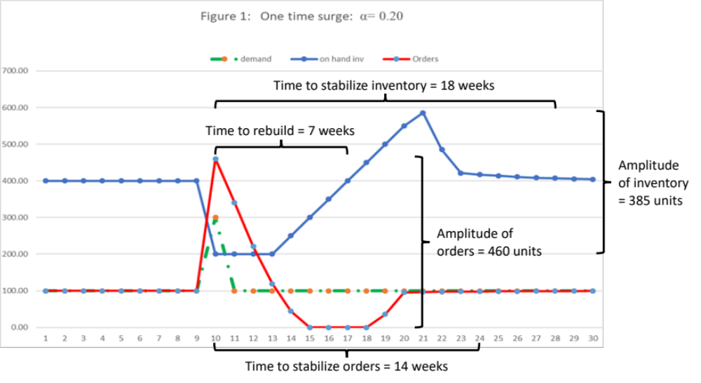
Supply Chain Challenges Paper

Slide 8
Group Exercise

Slide 9
Remanufacturing Problem Statement
Develop a DSS that helps Kodak, for a given set of programs, determine the optimal timing of new program introductions, the buildup of capacity, and eventual end-of-life of the program.
Problem dimensions
  Price is dependent on introduction period
  Multiple types of capacity exist. Some are very expensive and added only in big increments
  Product substitution exists as an alternative to introducing new products or expanding capacity for existing products
  Recycling partitions classes of capacity creating multiple cost structures that have to be properly managed

Slide 10
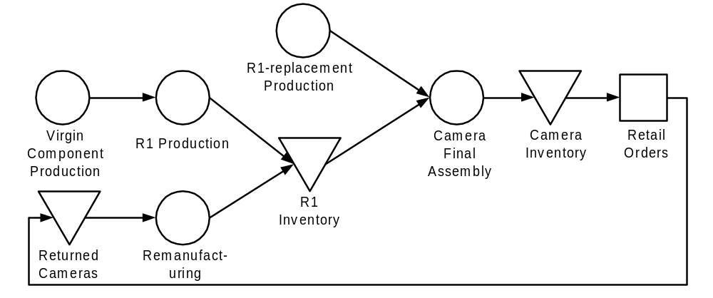
Program Definition
Informally, a program will sell at least 10M units over its life cycle
Programs typically have tens, if not hundreds, of SKUs
  Two programs might share the same optics but not same CB or form factor. Another program may share a common CB with one of the programs
  Typical program derivatives include sport models and activity-branded models
Single-program process flow
Notes:
D:\Kodak\SUC\Informal Talk

Slide 11
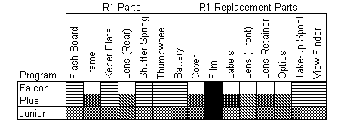
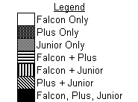
Multiple-Program Process Flow
Sharing of parts and manufacturing processes across programs significantly complicates process flow
For each capacity class, there are 2N-1 possible combinations of parts between programs
R1s versus R2s

Slide 12
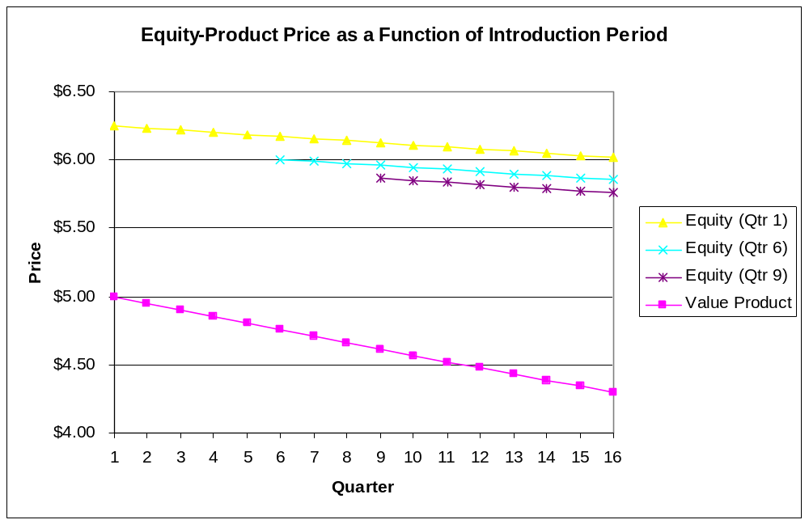
Product Price
Product family’s price is dependent on the introduction period; it is a fixed amount greater than the base product’s price in that period
Each product family has its own time-dependent price decrease
Value product’s price decreases 1% per qtr.
Equity product’s price decreases .25% per quarter.
Equity product’s enjoys a $1.25 price premium over the value product in the period it is introduced.

Slide 13
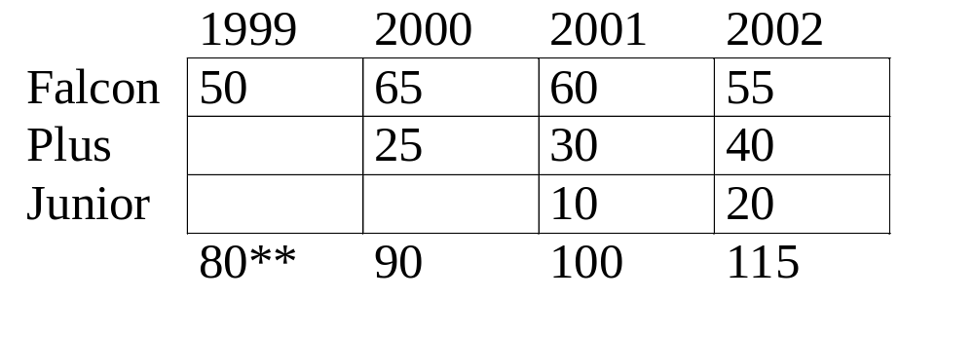
Demand
Demand is upward substitutable
  Unsatisfied demand for Junior can be fulfilled by Plus, and unsatisfied demand for Plus can be fulfilled by Falcon

Slide 14
Current Practice at Kodak
Expert consensus determines the timing of product family introductions
Detailed business-case analysis evaluates capacity requirements and expected costs
Current approach uses yearly time buckets
As complexity increases, it is unlikely that the optimal roll out is found by looking at two or three scenarios

Slide 15
Solution Technique
Mixed Integer Linear Program
  Integer variables are product family introduction periods and incremental capacity additions
  Maximize profit (sales revenue minus fixed development costs, variable manufacturing costs, fixed tooling costs, inventory costs)
Questions to answer
  How does recycling affect the timing and introduction of product families?
  How does recycling affect Kodak’s capacity acquisition strategy?
  Is maximizing recycling the proper strategy? Is this the most important lever to pull?
  Should Kodak pay more for carcasses during the initial quarters after a product launch?

Slide 16
Mathematical Program Details
Objective
  Maximize NPV for the ramp-up and ramp-down of the Falcon program over next five to ten years.
Decision Variables
  Timing of new product introductions
  Capacity levels (by product, time period, region)
  Production quantities (by product, time period, region)

Slide 17
Mathematical Program Details
Inputs
  Demand scenarios (by product, time, region, customer)
  Manufacturing cost profiles
    Volume discounts (by product, time, region)
    Time discount (by product, time)
    Virgin cost (by product, time, region)
  Tooling cost (by product, time, number of new carcasses, variation of product)
  Recycling dynamics
    Lag between use and return (by product, time, region)
    Yield (by product)
    R1, R2 (by product, time, region
  Price (by product, time, region)

Slide 18
Mathematical Program Details
Inputs (Cont’d)
  Capital costs; plant investment and automated equipment (by product, time, number of new carcasses, variation of product)
  EWO (by product, time, number of new carcasses, variation of product)
  Inception (by product, time, number of new carcasses, variation of product)
  Maintenance (by product, time, equipment type)

Slide 19

Please complete the end-of-class two-question survey
What is your main learning?
What is your unanswered question?
https://bit.ly/15763end

